Slide 1

Code pipeline
DATA ANALYTICS | IRONHACK

Slide 2

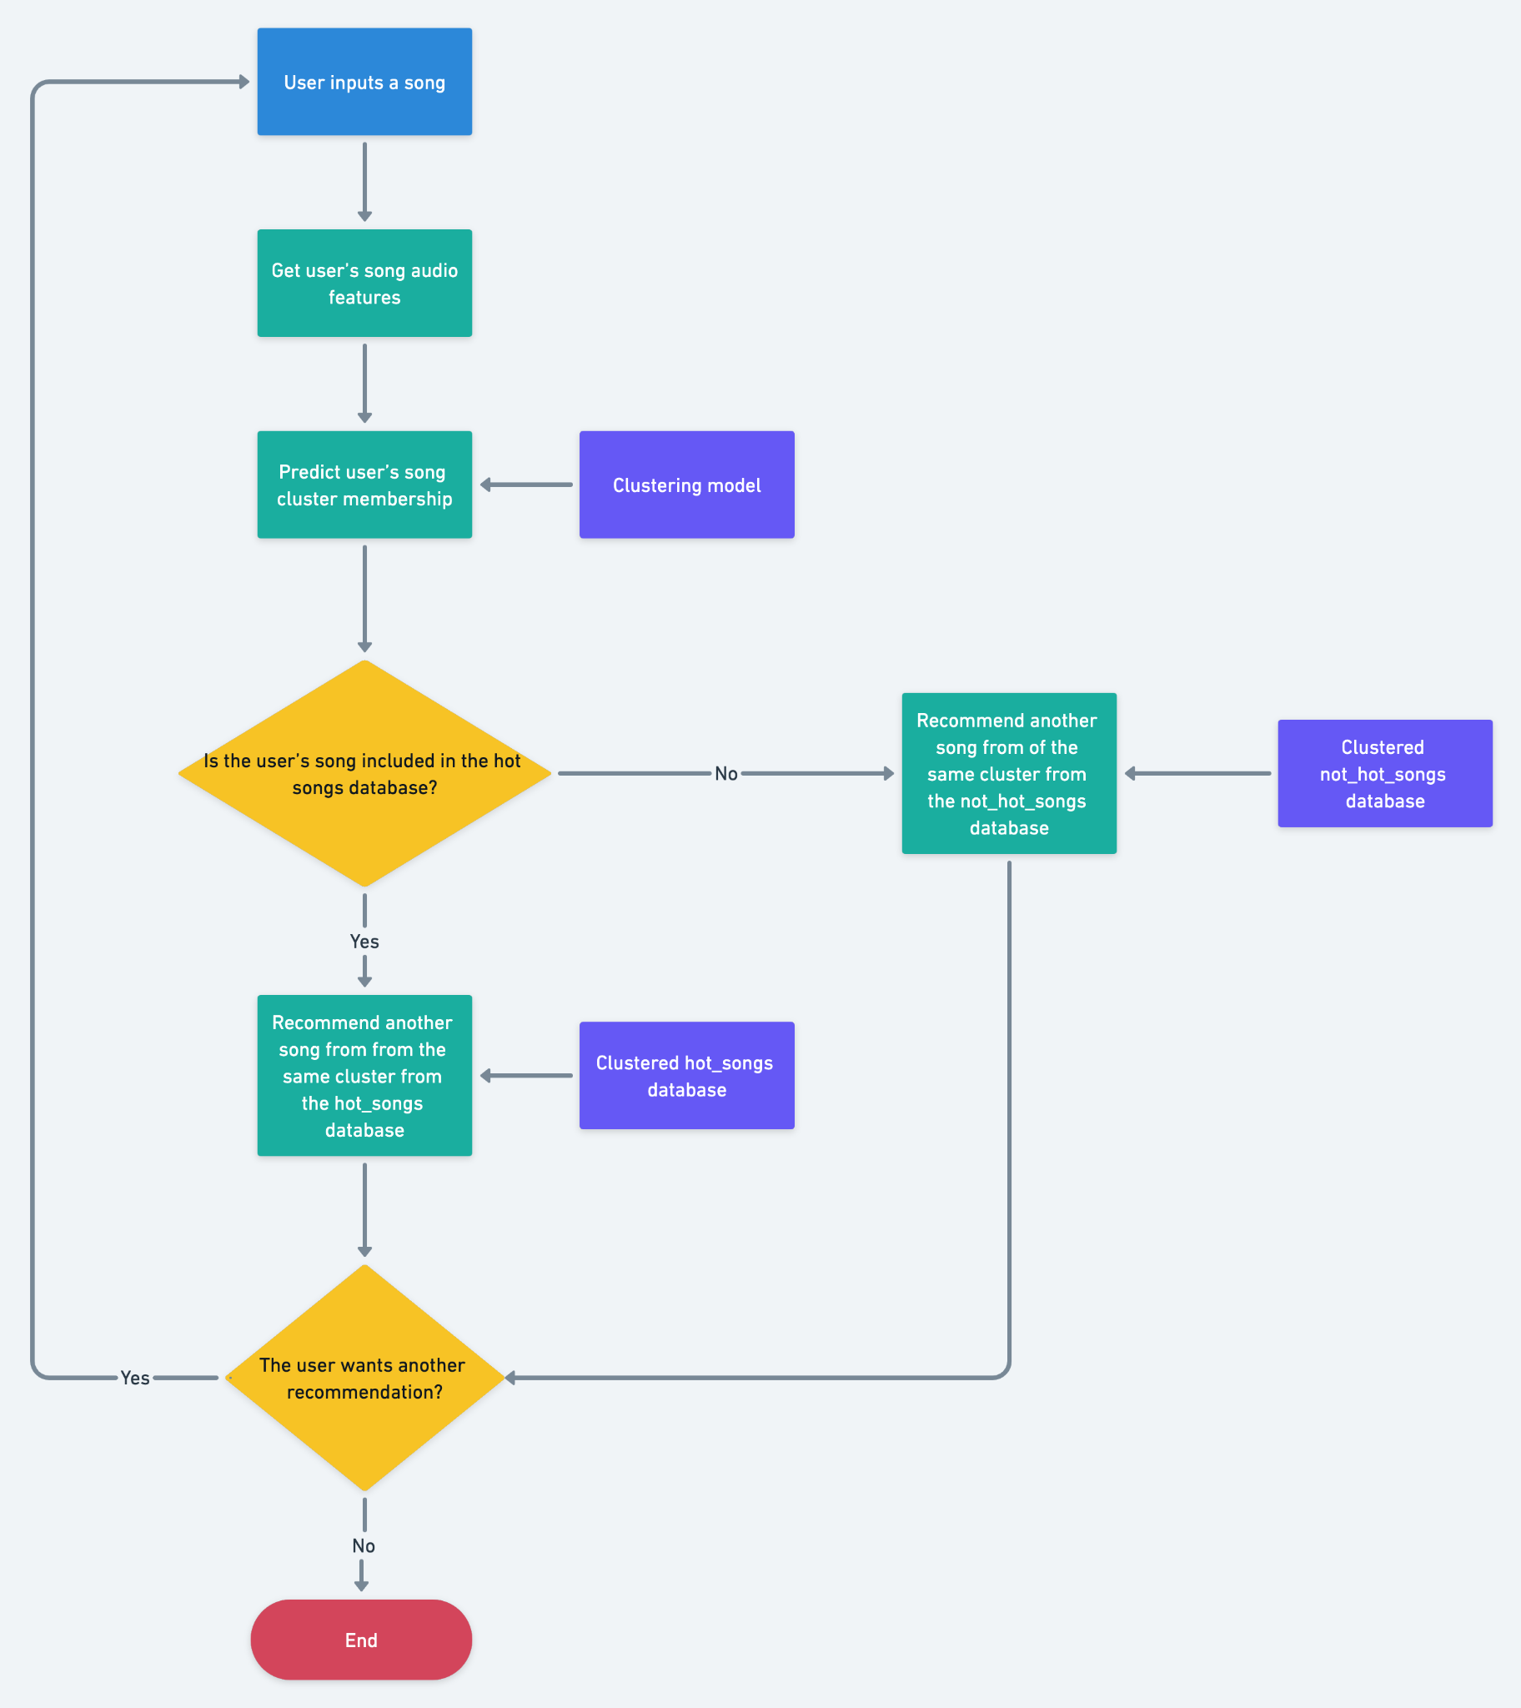
IRONHACK BOOTCAMP
CODE PIPELINE
Now it’s time to ensemble all the code pieces to produce the final code:

Slide 3


